Slide 1

12/2 Report
By Bolun

Slide 2
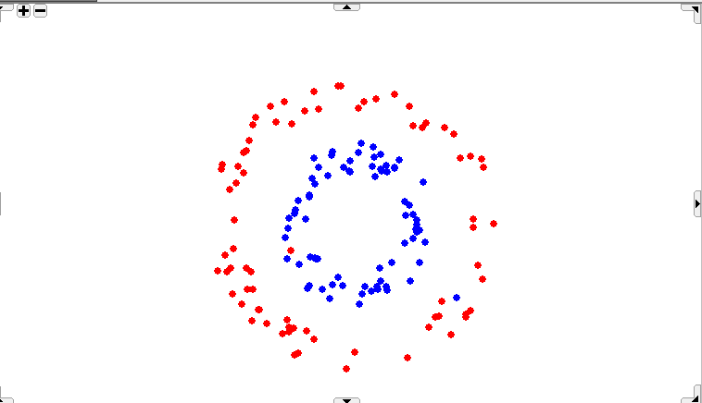
How the choice of epsilon is affecting the results?

Slide 3
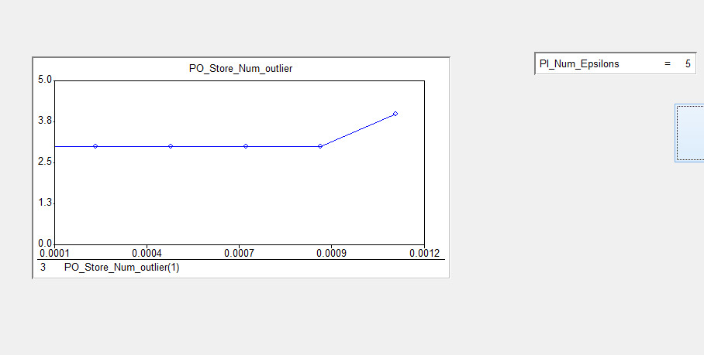
Idioms

Slide 4
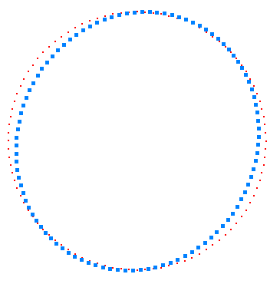
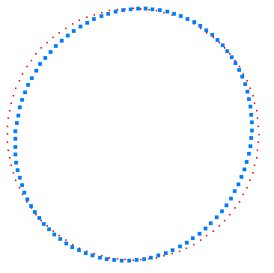
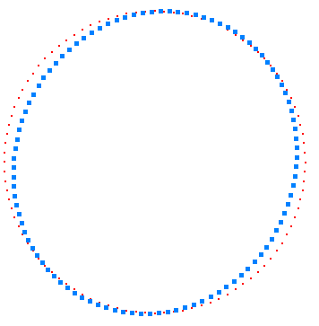
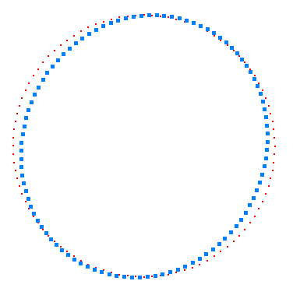
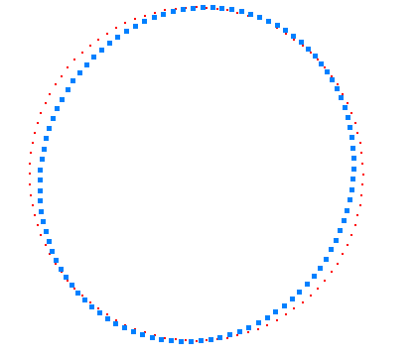
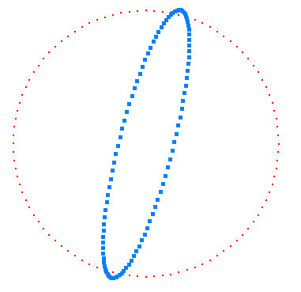
0/5 max epsilon
1/5 max epsilon
2/5 max epsilon
3/5 max epsilon
4/5 max epsilon
5/5 max epsilon
Idioms

Slide 5
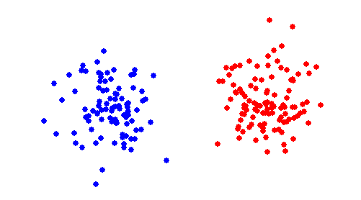
why we need to remove outliers before learning distance measure?

Slide 6
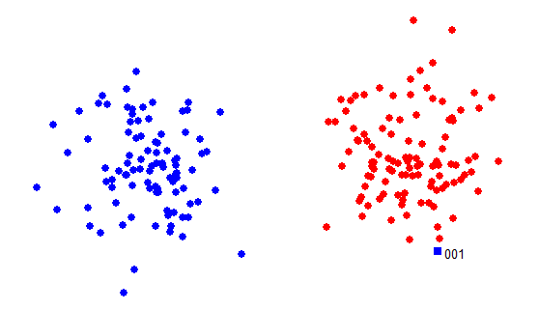
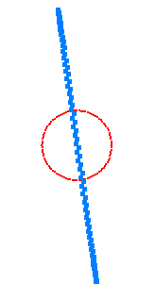
Solve Max Epsilon LP with 1 outlier

Slide 7
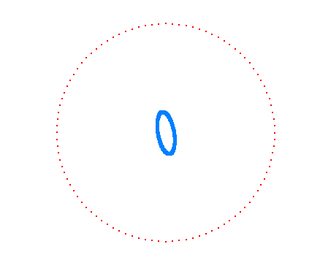
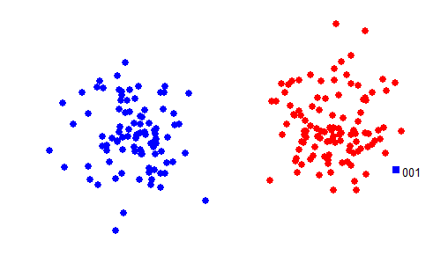
Solve Max Epsilon LP with 1 outlier

Slide 8
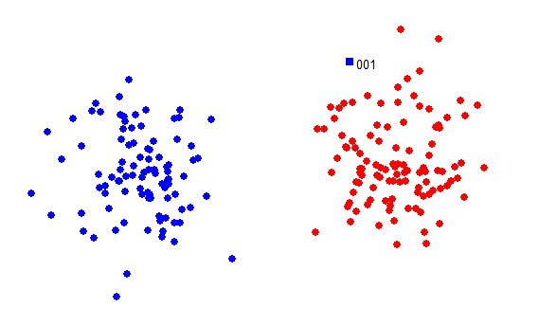
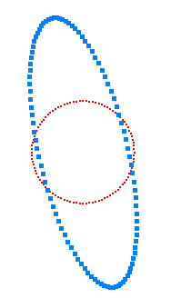
Solve Max Epsilon LP with 1 outlier

Slide 9
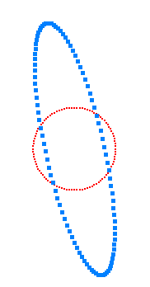
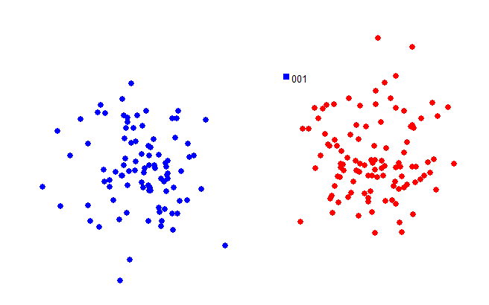
Solve Max Epsilon LP with 1 outlier

Slide 10
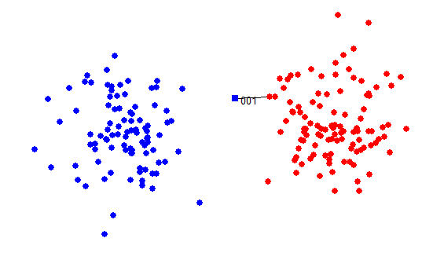
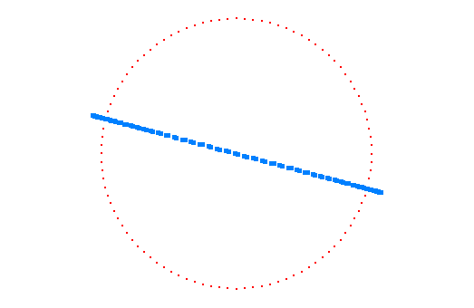
Solve Max Epsilon LP with 1 outlier

Slide 11
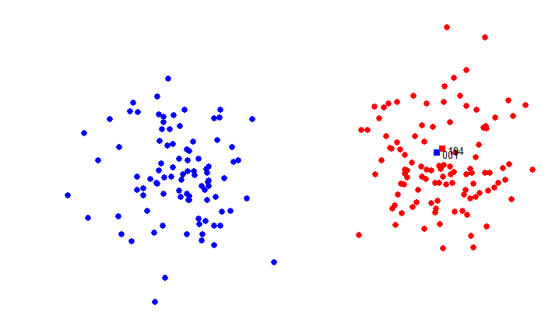
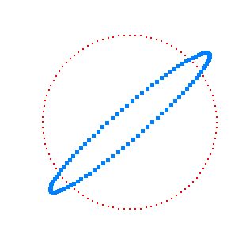
Solve Max Epsilon LP with 1 outlier

Slide 12
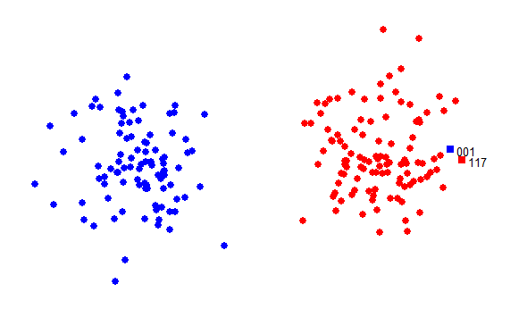
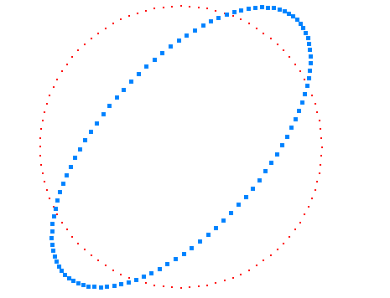
Solve Max Epsilon LP with 1 outlier

Slide 13
Start
Iterations with putting back points
Input Data
Solve LP
Delete Outliers from data
Outliers exist?
Yes
# of Iterations<# of outliers
Yes
No
No
Compute Ri of outliers
Output Data
Put a point back to data
Resolve LP
End
Is it an outlier?
Delete the point from data
Yes
No

Slide 14
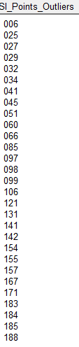
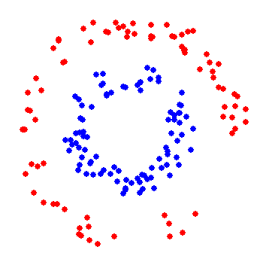
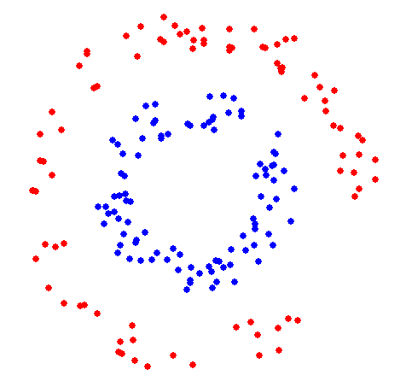
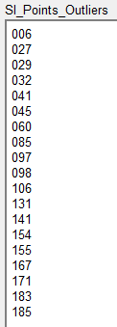
Before iterations
After 29 iterations

Slide 15
Start
Iterations with Ri
Input Data
Solve LP
Delete Outliers from data
Outliers exist?
Yes
# of Iterations<# of outliers
Yes
No
No
Compute Ri of outliers
Output Data
Put point with max Ri back to data
Resolve LP
End
Is it outlier?
Delete the point from data
Yes
No

Slide 16
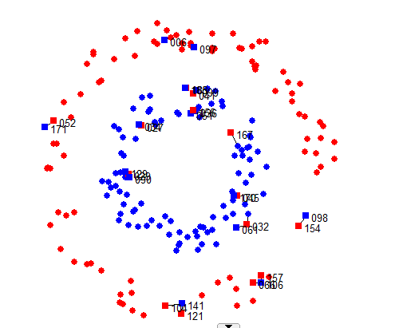
Original Data

Slide 17
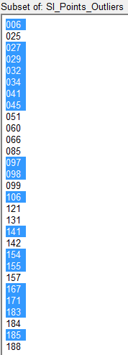
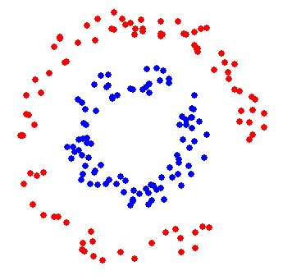
Before iterations
After 29 iterations

Slide 18
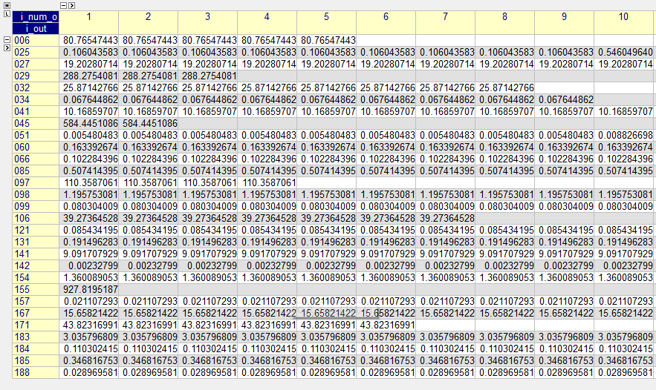
Data of Ri (with first 10 Iterations)

Slide 19
Iteration # 1 with Ri
# | Ri
155 | 927.8195
45 | 584.4451
29 | 288.2754
97 | 110.3587
6 | 80.76547
171 | 43.82317
106 | 39.27365
32 | 25.87143
27 | 19.20281
167 | 15.65821
41 | 10.1686
141 | 9.091708
183 | 3.035797
154 | 1.360089
98 | 1.195753
85 | 0.507414
185 | 0.346817
131 | 0.191496
60 | 0.163393
184 | 0.110302
25 | 0.106044
66 | 0.102284
121 | 0.085434
99 | 0.080304
34 | 0.067645
188 | 0.02897
157 | 0.021107
51 | 0.00548
142 | 0.002328

Slide 20
Iteration # 2 with Ri
# | Ri
45 | 584.4451
29 | 288.2754
97 | 110.3587
6 | 80.76547
171 | 43.82317
106 | 39.27365
32 | 25.87143
27 | 19.20281
167 | 15.65821
41 | 10.1686
141 | 9.091708
183 | 3.035797
154 | 1.360089
98 | 1.195753
85 | 0.507414
185 | 0.346817
131 | 0.191496
60 | 0.163393
184 | 0.110302
25 | 0.106044
66 | 0.102284
121 | 0.085434
99 | 0.080304
34 | 0.067645
188 | 0.02897
157 | 0.021107
51 | 0.00548
142 | 0.002328
155

Slide 21
Iteration # 3 with Ri
# | Ri
29 | 288.2754
97 | 110.3587
6 | 80.76547
171 | 43.82317
106 | 39.27365
32 | 25.87143
27 | 19.20281
167 | 15.65821
41 | 10.1686
141 | 9.091708
183 | 3.035797
154 | 1.360089
98 | 1.195753
85 | 0.507414
185 | 0.346817
131 | 0.191496
60 | 0.163393
184 | 0.110302
25 | 0.106044
66 | 0.102284
121 | 0.085434
99 | 0.080304
34 | 0.067645
188 | 0.02897
157 | 0.021107
51 | 0.00548
142 | 0.002328
45
155

Slide 22
Thank you !

